Slide 1
Employment communication
Unit 7

Slide 2
Employment Communication
Check sample resume
Does it look balanced and attractive?
What information is included each major section?

Slide 3
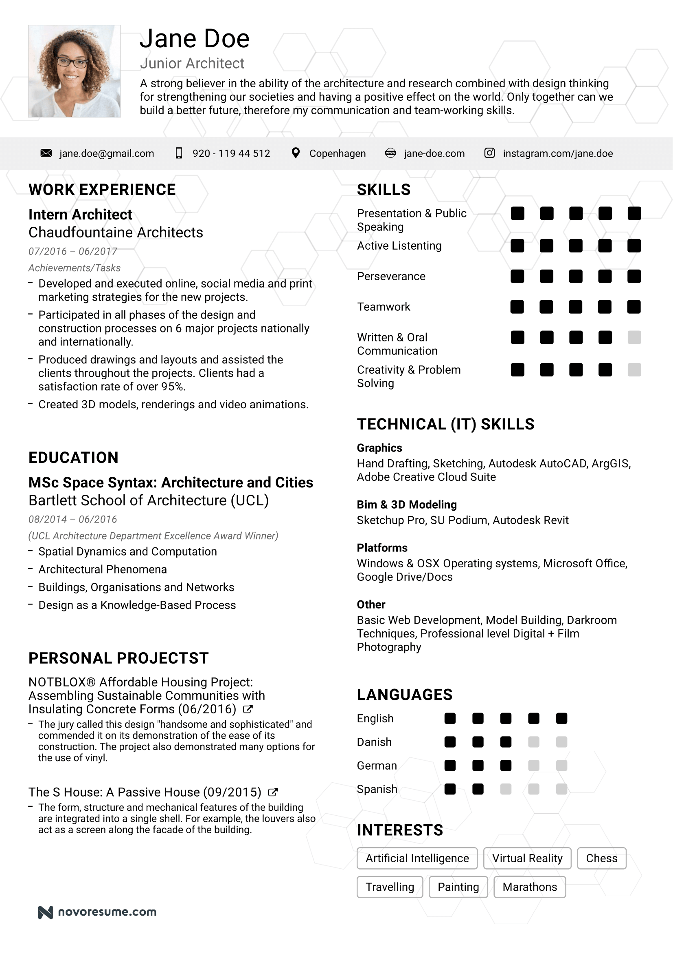

Slide 4
Get started
You will apply for your dream job
You will need attractive and well crafted employment communication
Highlight your strengths
Use technical writing skills to analyze audience’s needs
Resume (one or two page summary of your qualifications)
Cover letter (to accompany the resume)

Slide 5
Importance of Resume and COVER LETTER
Create a professional, favorable impression
Allow you to control the presentation of your skills on paper
Encourage an employer to call you to arrange an interview
Give employers to look at your capabilities before you fill applications which they may require

Slide 6
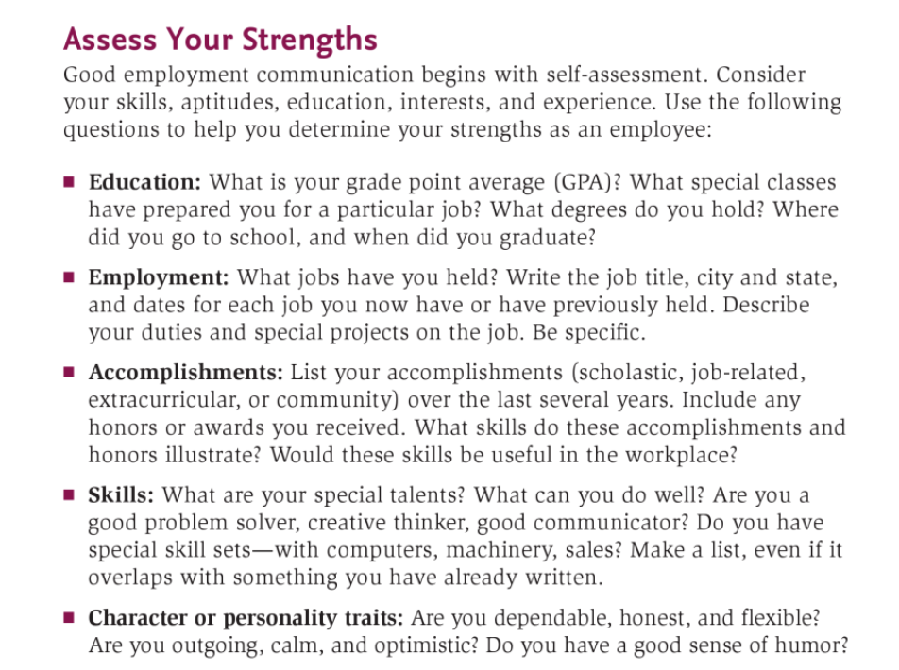

Slide 7
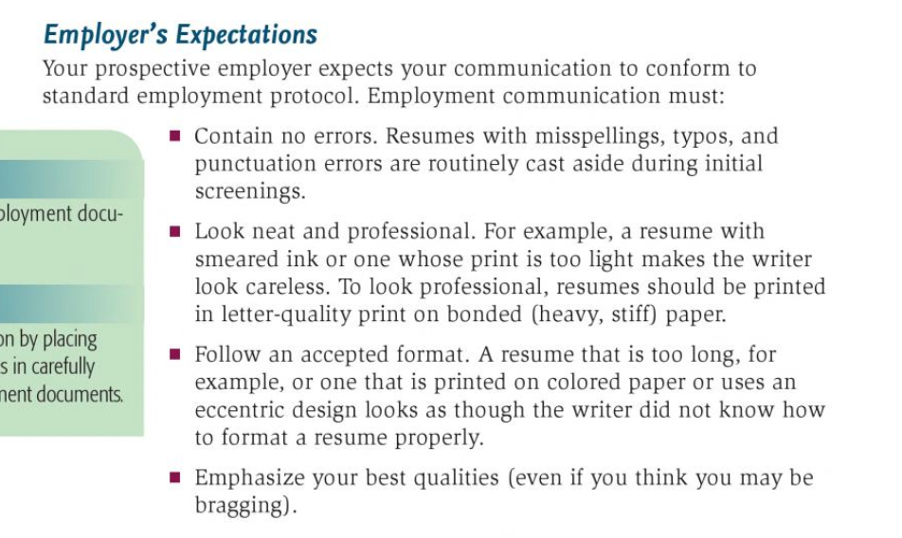

Slide 8
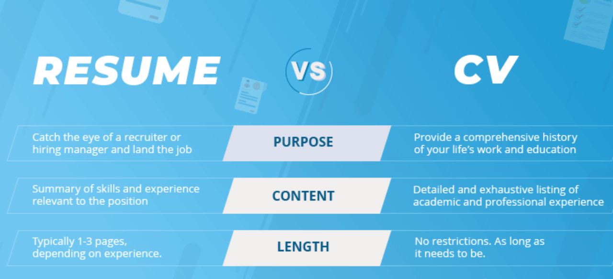
DIFFERENCE BETWEEN RESUME AND CV

Slide 9
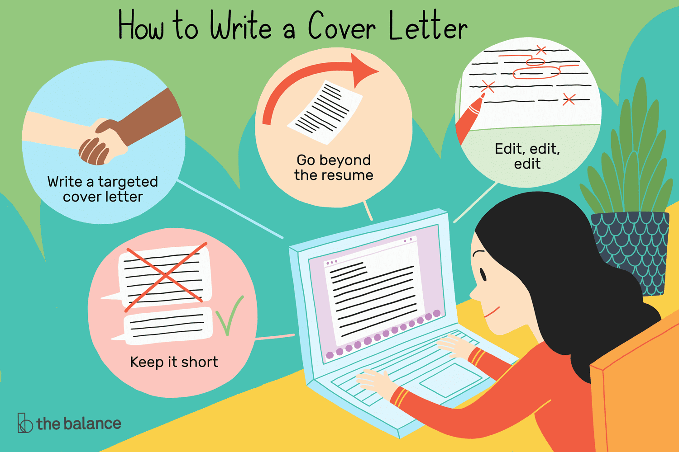
COVER LETTER
Provides opportunity to inform the employer how s/he could contribute to the company and fulfill the obligations of particular job position
It is the first thing the employer looks at
So you want to make a good impression through it

Slide 10
